Slide 1




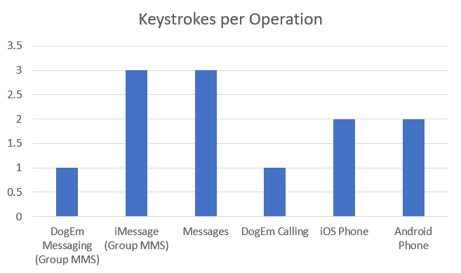
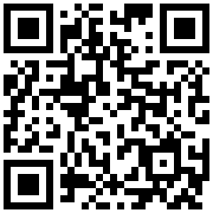

DogEm
UC-238
INTRO/ABSTRACT
Maintaining communication can often be overwhelming. Factors such as distance, scheduling conflicts, and technical hurdles can prove to be major obstacles for keeping in touch. DogEm's purpose is to address this need while ensuring ease of use for users by allowing for semi-automated messaging and calling. By using semi-automated repeated messaging via multiple avenues including text, call, and email, DogEm users are able to send their contacts large volumes of messages and calls quickly and reliably.
DogEm is a cross-platform mobile application developed with React Native, Firebase, and Expo CLI to facilitate semi-automated SMS messaging and calling from a user’s device.
TOOLS
RESULTS
The DogEm App is capable of sending SMS messages with 1/3 of the keystrokes of conventional messaging and it is capable of calling with 1/2 of the keystrokes of conventional calling.
DogEm App’s Website:
Authors: Zane Atkinson, Chloe Chung, Melissa Iniestra, Deo Intshakal A Nzeng, and Joshua Willson
Advisor: Dr. Sharon Perry

